Slide 1
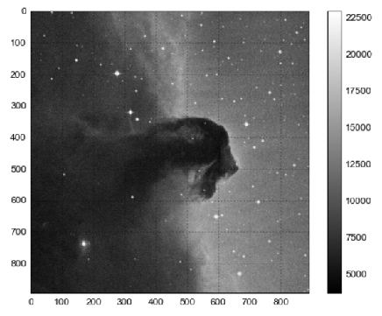



!!! TITLE
!!! SUBTITLE
PREPARED BY
MATT HOLMAN
PAUL BLANKLEY
RYAN JANSSEN
STRICTLY PRIVATE AND CONFIDENTIAL
30 NOVEMBER 2017

Slide 2
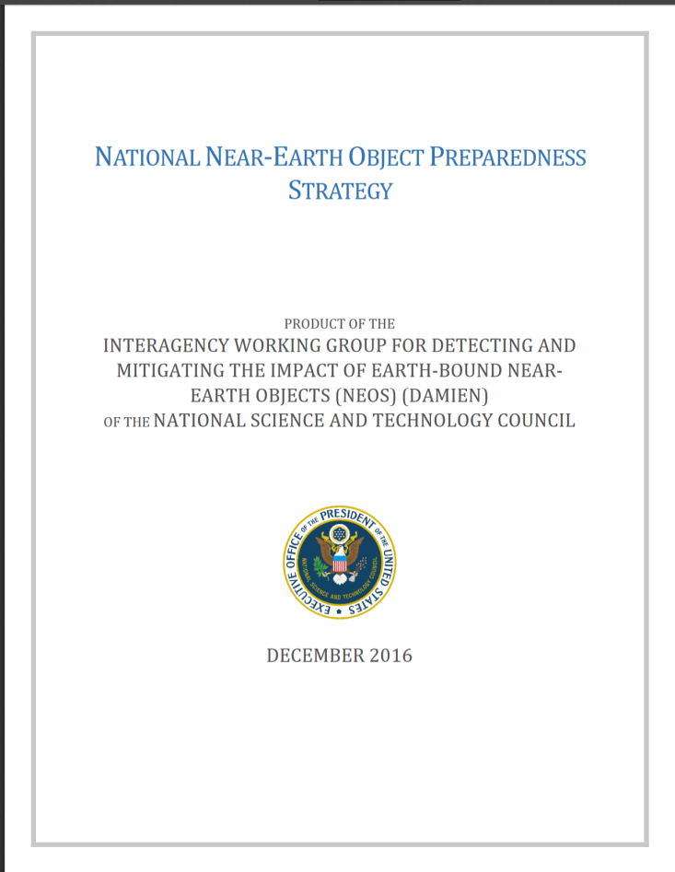
MILLIONS OF MISSING ASTEROIDS!
CONNECTING PARTIAL ASTEROID TRACKLETS
MANDATE FROM CONGRESS:
>90% OF POTENTIALLY HAZARDOUS ASTEROIDS MUST BE TRACKED
CURRENTLY, WE HAVE 170m OBSERVATIONS OF KNOWN ASTEROIDS

Slide 3
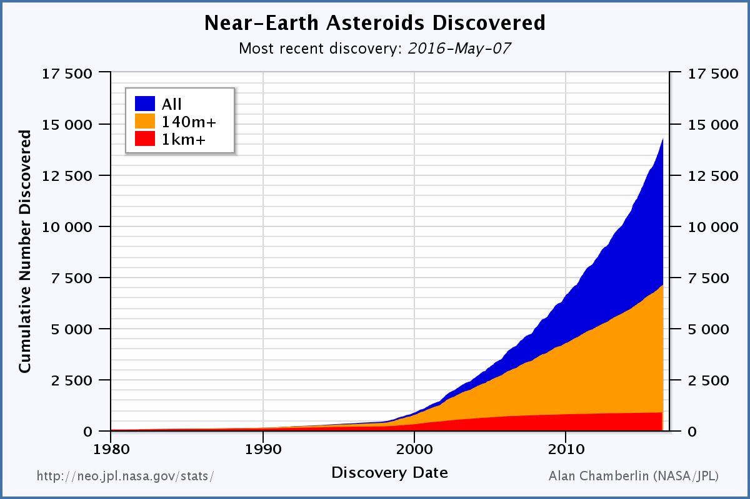
MILLIONS OF MISSING ASTEROIDS!
CONNECTING PARTIAL ASTEROID TRACKLETS
HOWEVER, THERE ARE OVER 14m OBSERVATIONS THAT CANNOT BE CURRENTLY MATCHED

Slide 4
A HARD PROBLEM…
!!!
!!!
We are observing the asteroids from the earth, so the orbits can appear highly non-linear.
We cannot just brute force search the space because orbit fitting is very expensive, and there are 14m observations in the ITF.

Slide 5
…A SOLUTION!
!!!
!!!
Current solution: Pan-STARRS Moving Object Processing System (MOPS). This approach is very computational expensive. It requires a cluster computer and months of time to find matches.

Slide 6
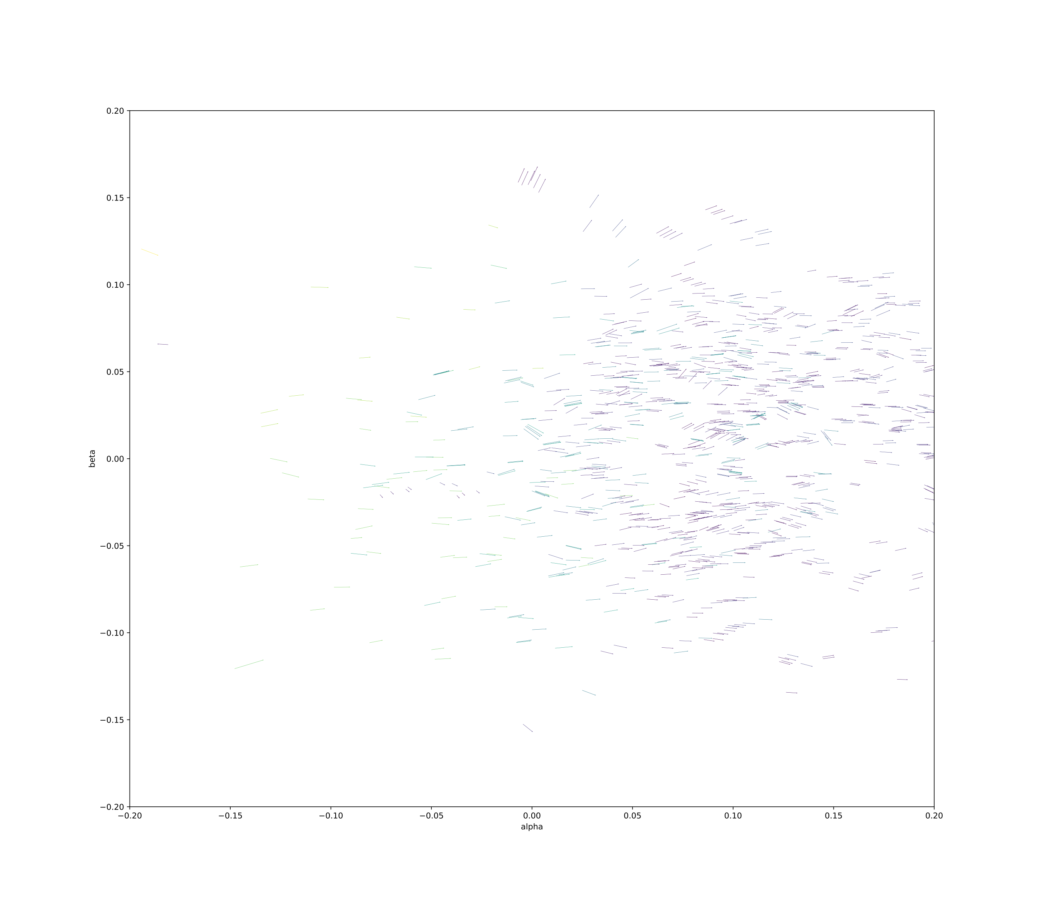
THE VIEW FROM THE SUN

Slide 7
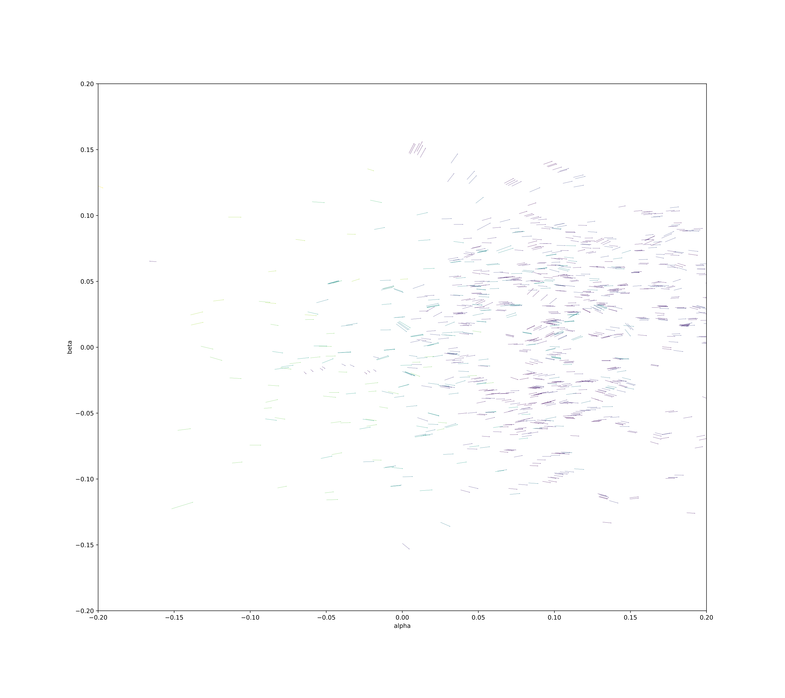
THE VIEW FROM THE SUN

Slide 8
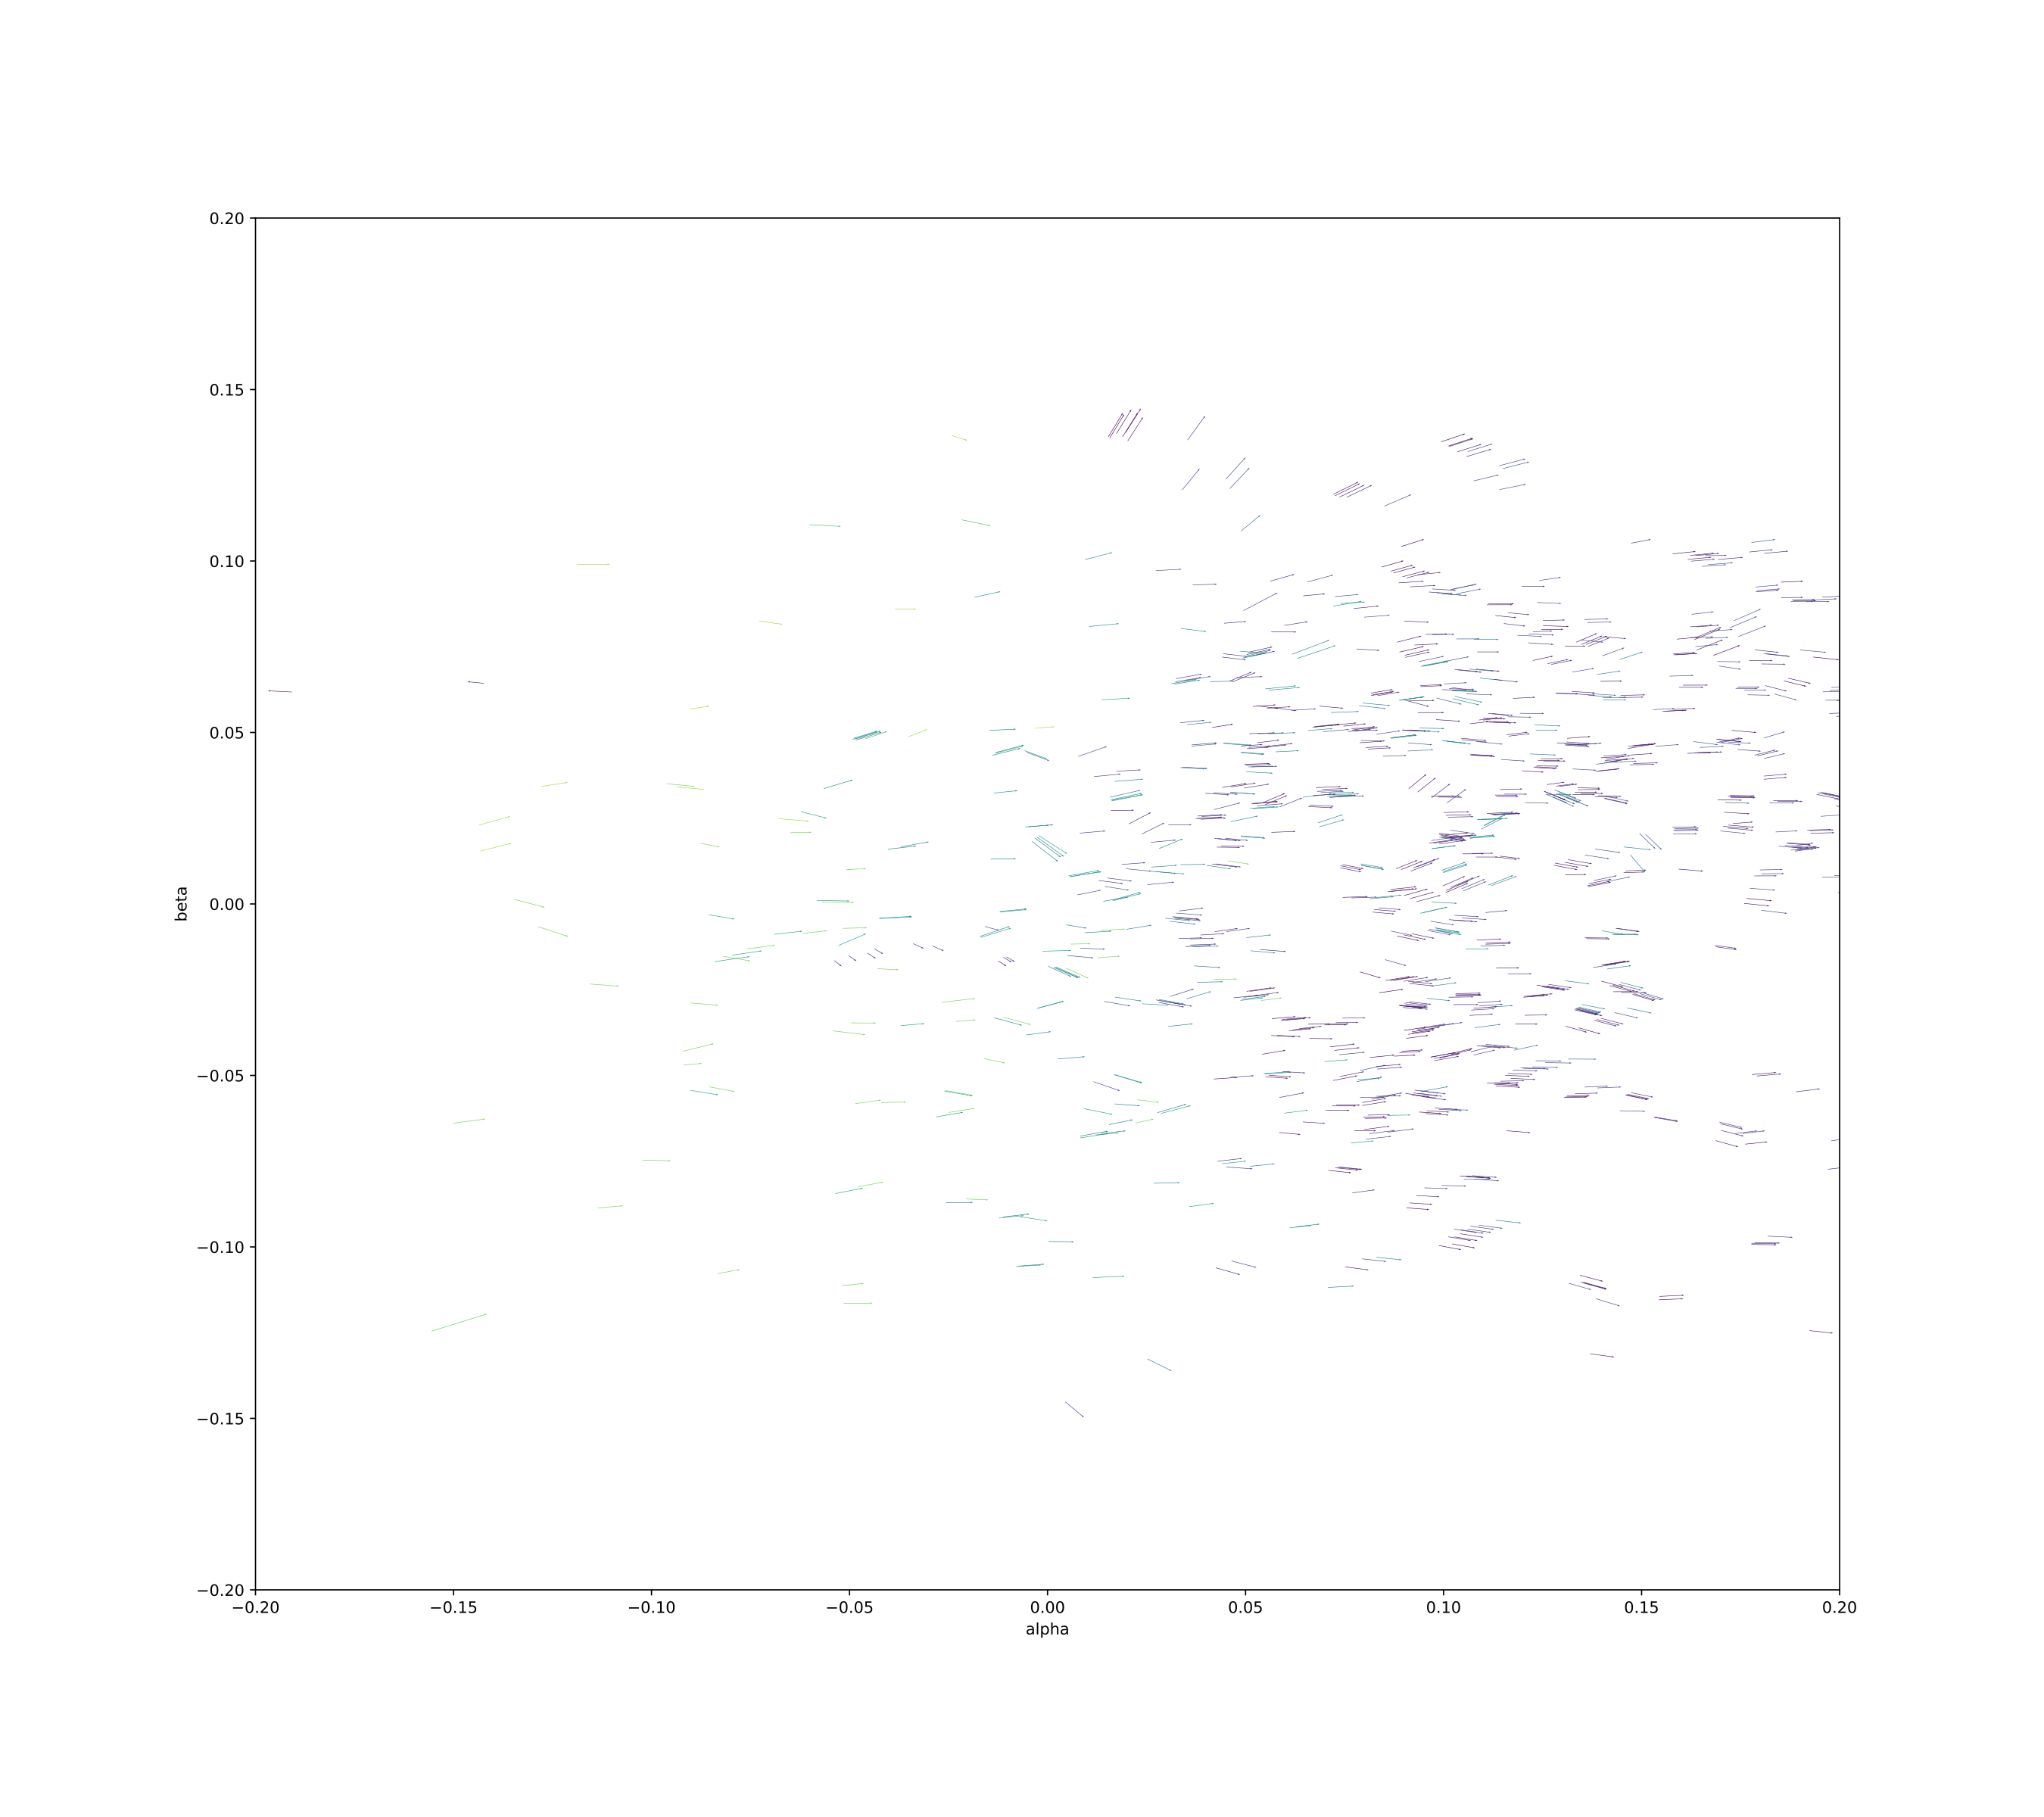
THE VIEW FROM THE SUN

Slide 9
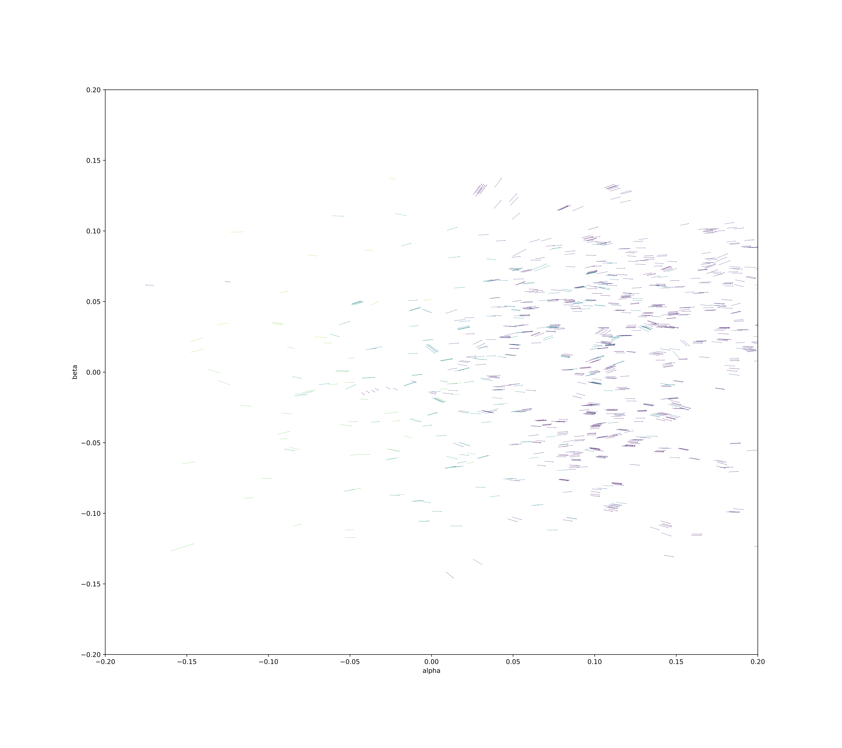
THE VIEW FROM THE SUN

Slide 10
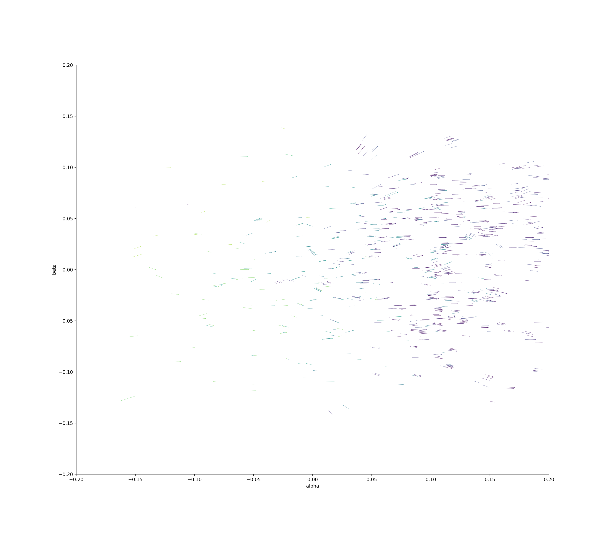
THE VIEW FROM THE SUN

Slide 11
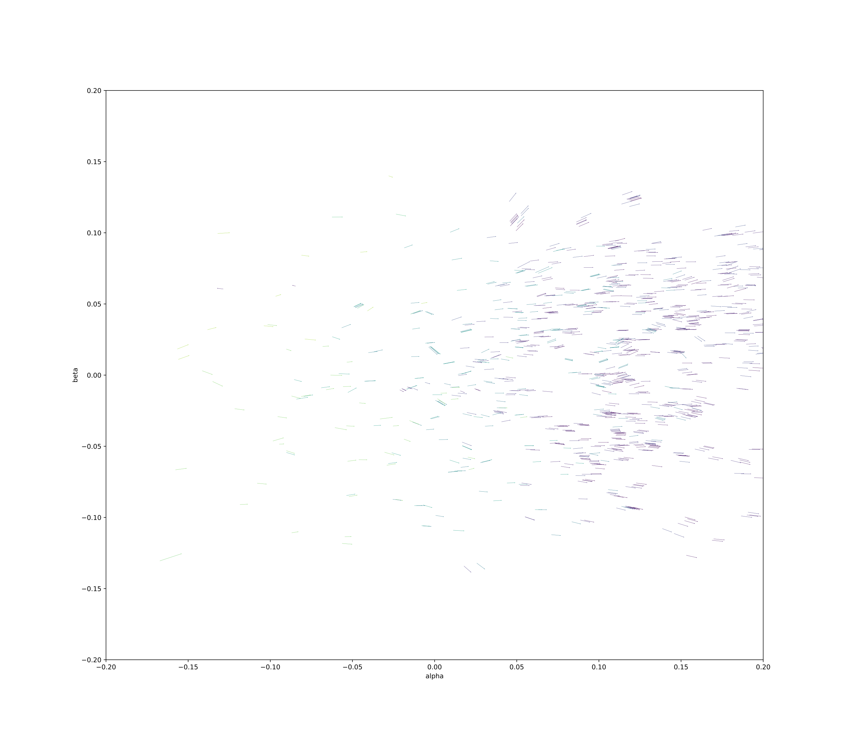
THE VIEW FROM THE SUN

Slide 12
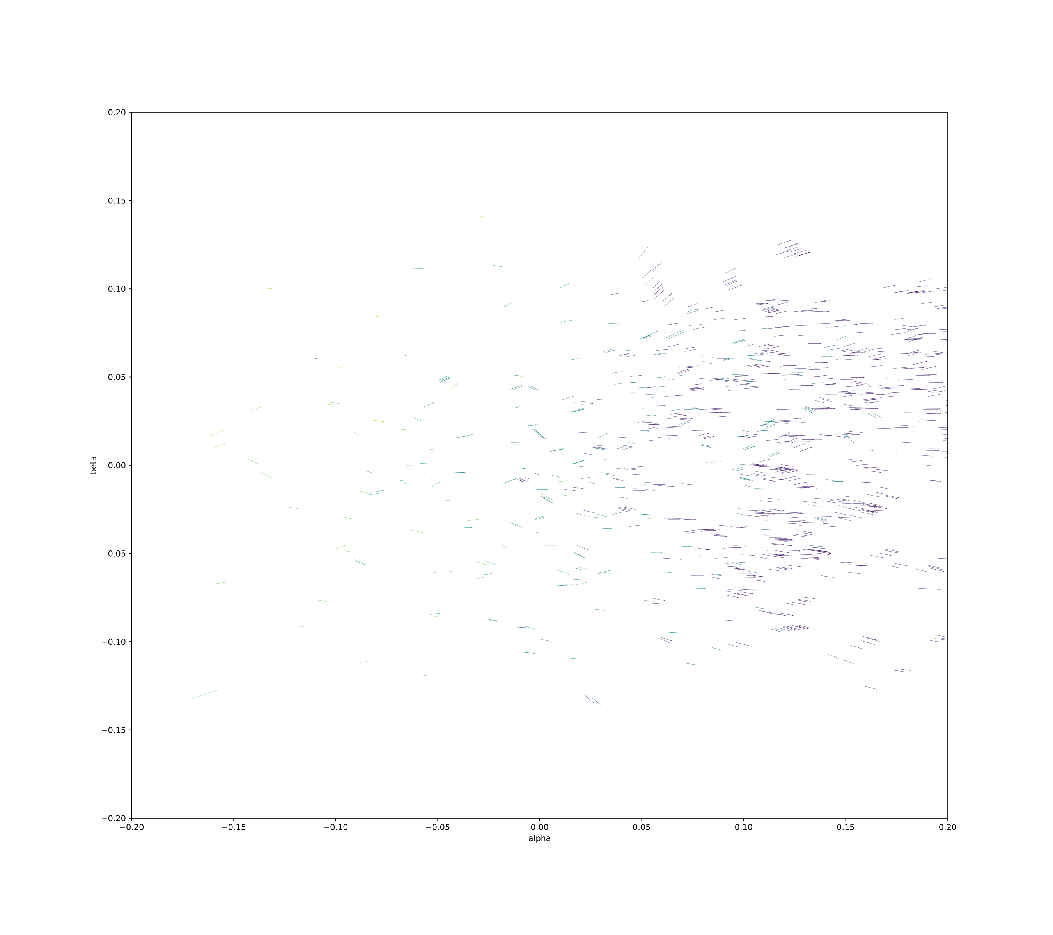
THE VIEW FROM THE SUN

Slide 13
CORE INTUITION
We propose a transformed heliocentric view.
This view lets us compare asteroid tracklets in common time.
Since the heliocentric view allows comparison in common time, it makes clustering methods very applicable.
HELIOCENTRICITY

Slide 14
OUR METHODOLOGY I
!!!
1. Heliocentric transform: We assert a distance from the sun (2.5 au), and then derive the distance of the object from the earth.
2. We divide the sky into regions and chunks of time. We then project the asteroid tracklets to a tangent plane.

Slide 15
OUR METHODOLOGY II
!!!

Slide 16
TUNING HYPERPARAMETERS
THANKS TO MINOR PLANET CENTER FOR TRAINING SET!
…AND NOW, MORE STUDENTS ARE LAUNCHING THEIR PROJECTS AFTER THE GSP.

Slide 17
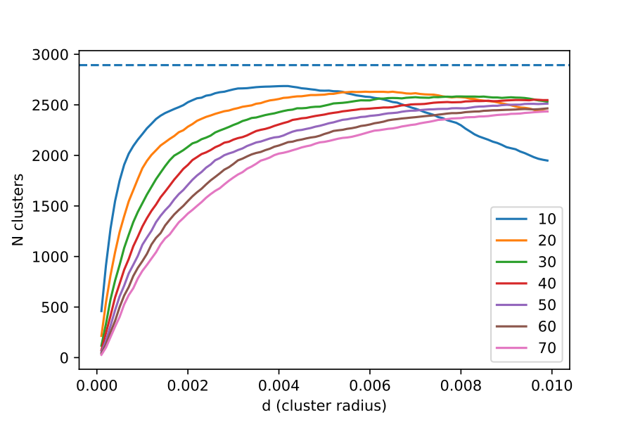
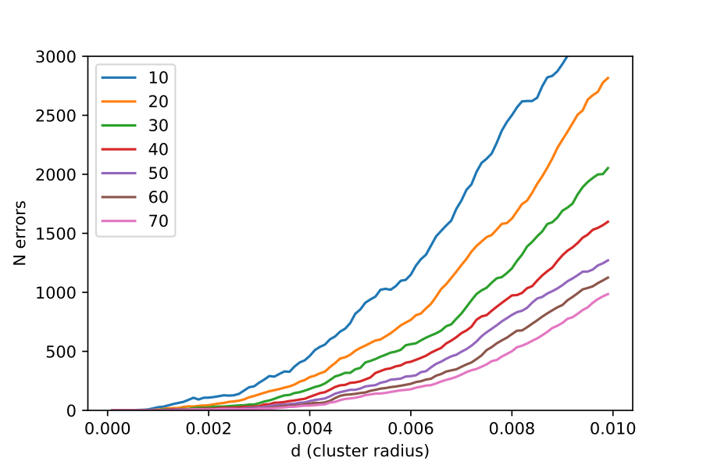
TUNING PERFORMANCE
!!!

Slide 18
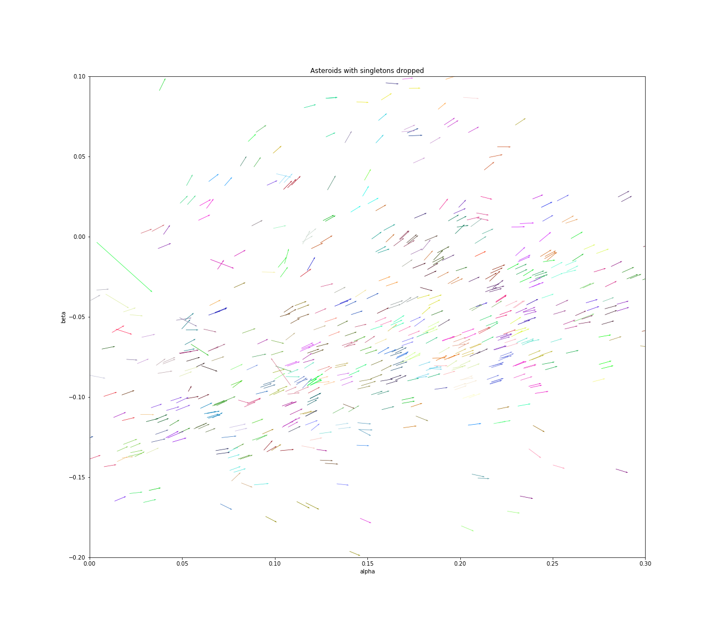
RESULTS
!!!
Clusters are colored with singletons dropped.

Slide 19
CONCLUSIONS, LIMITATIONS, NEXT STEPS
CONNECTING PARTIAL ASTEROID TRACKLETS
We were able to find matching tracklets using the heliocentric transform
We were also able to do so in just O(n log n) time, scalable solution!!
…AND NOW, MORE STUDENTS ARE LAUNCHING THEIR PROJECTS AFTER THE GSP.

Slide 21
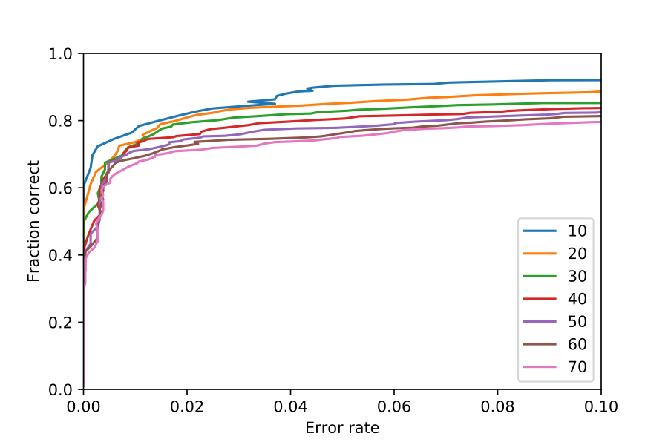

Slide 22
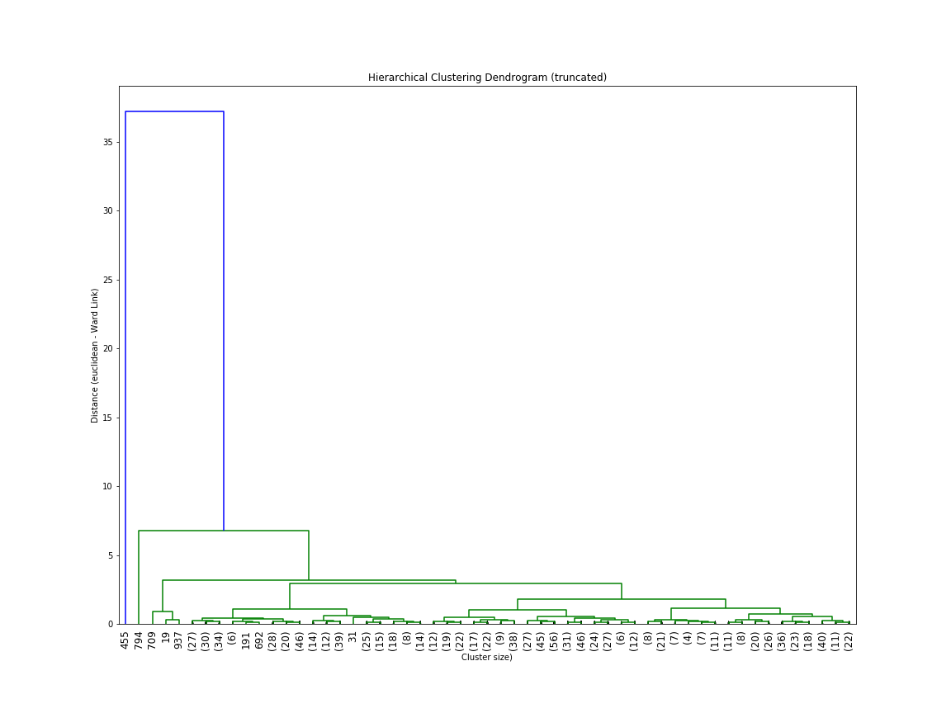

Slide 23
The first insight which becomes apparent from the study is that Singularity University is doing a great (and increasingly great) job!
The 2014 class created a much higher number of new entrepreneurs than the 2013 class (almost double).
The 2014 class also increased its number of technically-skilled students (which we will see later is important to business creation).
2013 vs 2014 GSP
GREAT PROGRESS
BEFORE GSP
BEFORE GSP
AFTER GSP
AFTER GSP
SINGULARITY CREATED ALMOST TWICE AS MANY ENTREPRENEURS IN 2014…

Slide 24
Secondly, the overall number of students who chose to launch their projects after the GSP has increased by one third in the past year.
As a key metric of this study, and (as I understand) a top priority for the University, this is a huge win.
The question, then, is what is driving this improvement? And how can SU continue to improve?
We’ll examine these questions in detail over the next several slides.
2013 vs 2014 GSP
GREAT PROGRESS
Proportion of students with GSP project businesses post-graduation:
18%
2013 GSP
2014 GSP
24%
…AND NOW, MORE STUDENTS ARE LAUNCHING THEIR PROJECTS AFTER THE GSP.

Slide 25
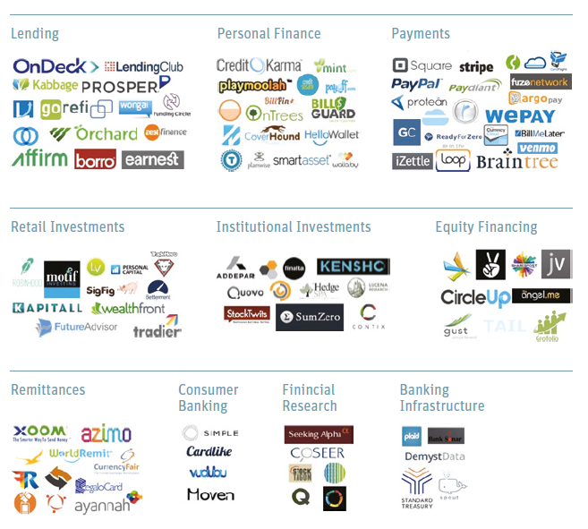

A DIVERSE SECTOR
FINTECH AND FINANCIAL SERVICES
A unique investing skill-set
In my experience investing in Fintech, I’ve learned that the sector needs both a unique skill-set and approach
Fintech is unique to other growth sectors in several ways:
Regulation – Understanding regulatory environment (and more importantly, how regulation may change) is highly important for managing downside risk
Incumbents – Companies within the sector are often displacing large, entrenched incumbents. Focus and speed are key
Differentiation – Capital is a commodity. A clear, sustainable competitive advantage is especially important here. And the advantage must be structural to the business model, rather than dependent on team or a short-term relationship
The following pages present three sector opportunities which satisfy these requirements
source: Silicon Valley Bank, CB Insights

Slide 26

INSIGHT #1
TECHNICAL STUDENTS
82% OF ALL TEAMS THAT LAUNCHED THEIR PROJECT POST-GSP HAD A TECHNICAL TEAM-MATE.
82%
The GSP Needs Techies!
Out of every factor I examined, the single-most important factor for post-GSP success is presence of technical team members.
Each team with a technical team member in 2013 or 2014 was 44% more likely to continue their project post-GSP (versus non-technical teams).
Multiple technical team members on a team did not add additional success.
Back calculation shows the ideal ratio of technical members in the class should be between 25% and 30%.
TEAMS WITH AT LEAST ONE TECHNICAL MEMBER WERE 44% MORE LIKELY TO LAUNCH THEIR PRODUCT.

Slide 27

SINGULARITY GSP
AND POST-GSP SUCCESS
A High-Potential Organization
Singularity University is a leading institution at the forefront of innovation, with some of the highest potential for creating lasting change.
So why, then, don’t more Singularity University class projects become real-world businesses?
High-Potential Projects
I’ve set out to understand the reasons why this is, by performing a deep-dive data analysis on previous classes.
In this document, I’ll:
share these key insights, and
highlight what actions could be taken to help more SU GSP projects become global businesses.
At a glance:
(ALL 2013 VALUES) | VODAFONE GMBH | VODAFONE GROUP PLC
Domicile | Germany | UK
Headquarters | Dusseldorf | Newbury, Berkshire
Employees | >11,000 | >91,000
Customers | 32 million | 404 million
Turnover | €9.5 billion | €44.4 billion
EBITDA | €3.4 billion | €13.3 billion
EBITDA Margin | 35% | 30%
Ownership | 100% subsidiary of Vodafone Group PLC | FTSE 100 listed, $180bn market cap (Oct-2013)

